Slide 1

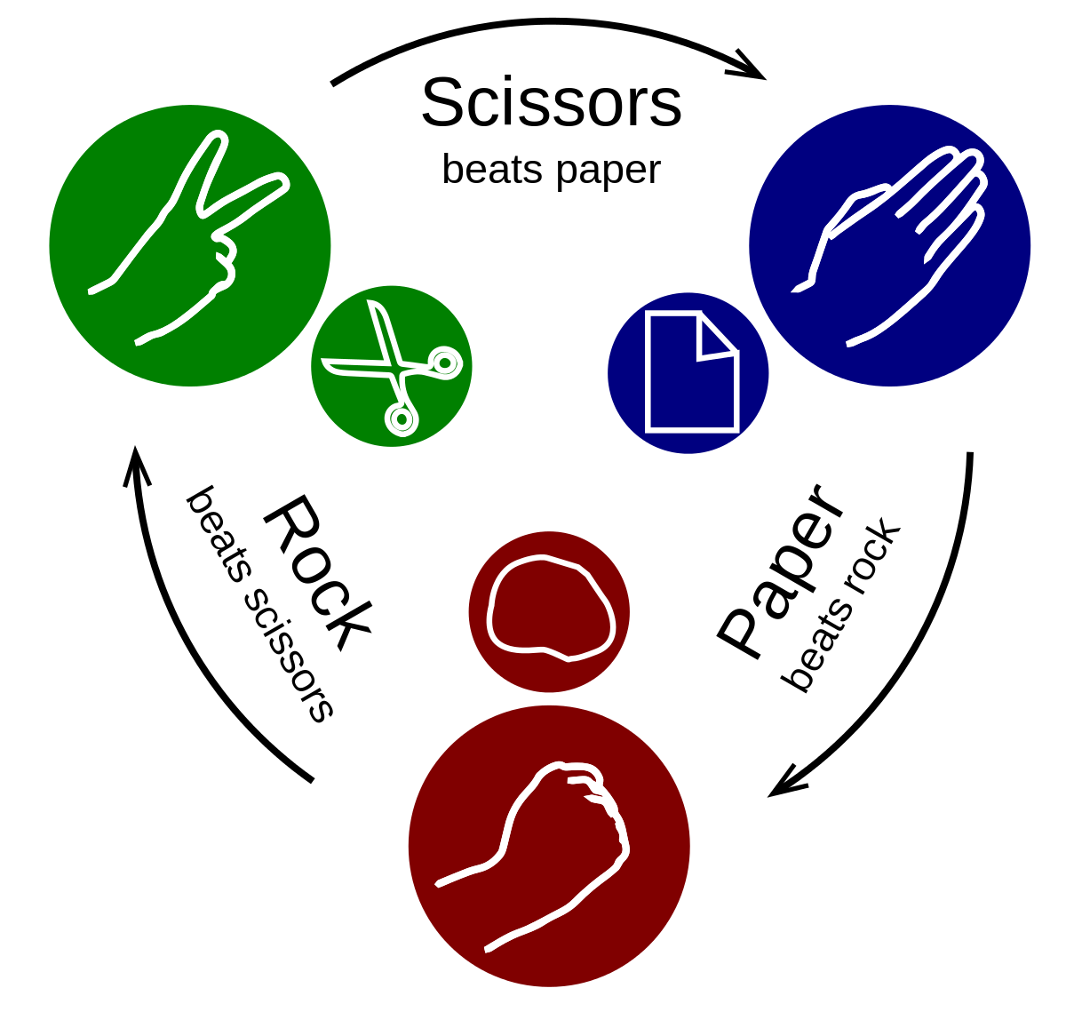
Stone, Paper, Scissor? Game Using Random

Slide 2
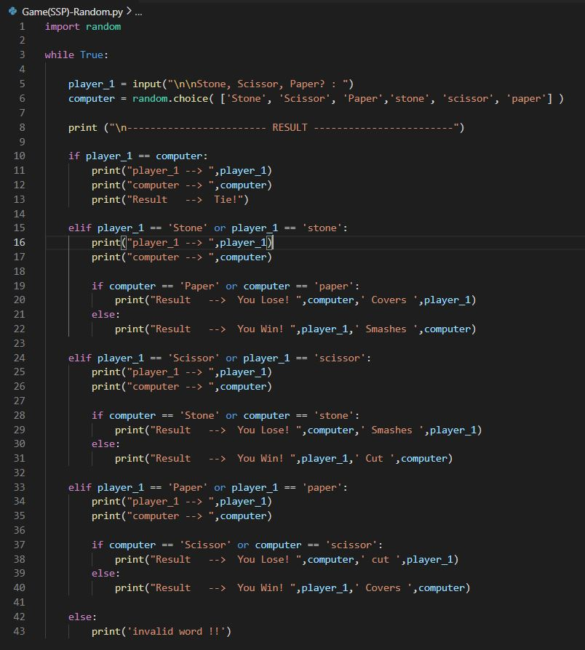
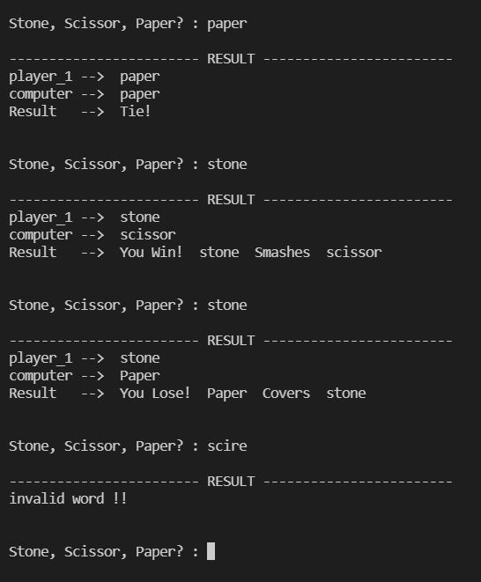
PYTHON SNIPPET
OUTPUT

